Slide 1
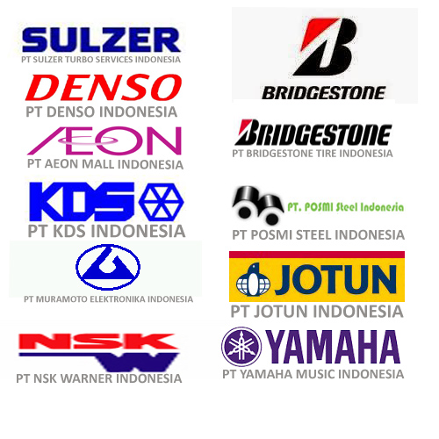
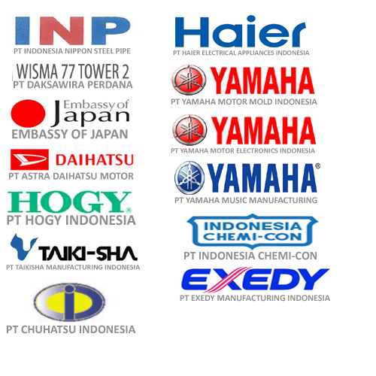


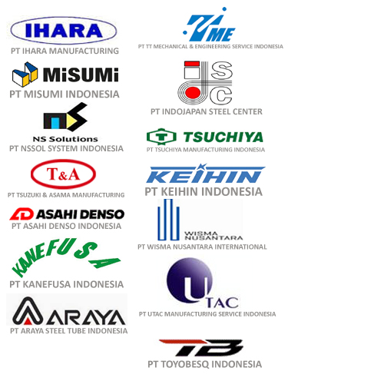
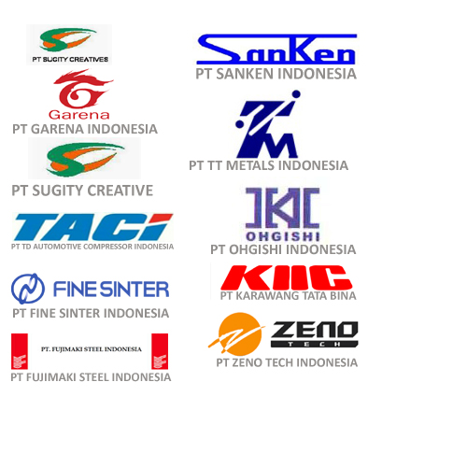

REFERENSI CUSTOMER
MALL
DORMITORY & APARTEMENT
RUMAH SAKIT
OFFICE BUILDING

Slide 2
REFERENSI CUSTOMER
FACTORY

Slide 3
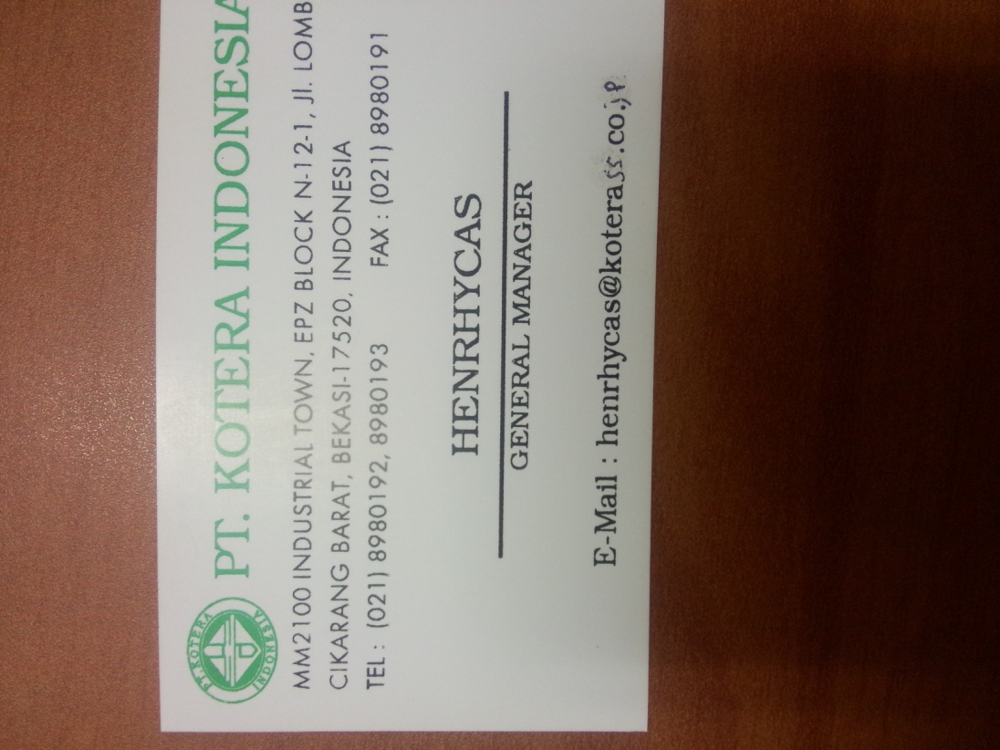








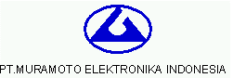




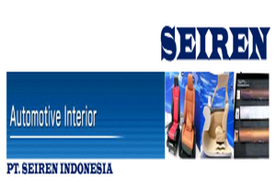


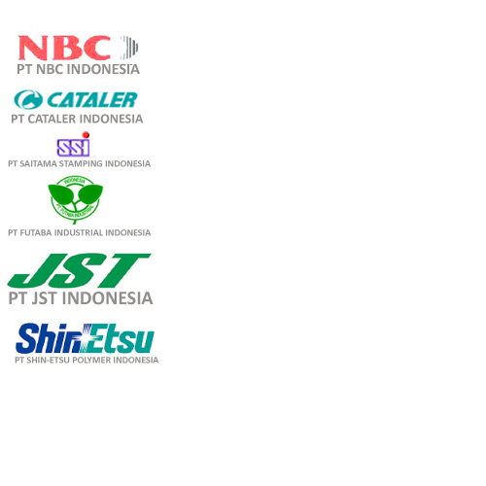

REFERENSI CUSTOMER
FACTORY
PT KEIHIN INDONESIA
PT KDS INDONESIA
PT KOTERA INDONESIA
PT MEITOKU WADAYAMA INDONESIA
PT KARAWANG TATA BINA
PT MEIDOH INDONESIA
PT TAIKISHA MANUFACTURING INDONESIA
PT KATOLEC INDONESIA
PT MISUMI INDONESIA
PT MURAMOTO ELEKTRONIKA INDONESIA
PT NBC INDONESIA
PT NSK WARNER
PT POSMI STEEL INDONESIA
PT SEIREN INDONESIA
PT SUGITY CREATIVE
PT OHGISHI INDONESIA
PT SHIN-ETSU POLYMER INDONESIA
PT SMAP INDONESIA

Slide 4










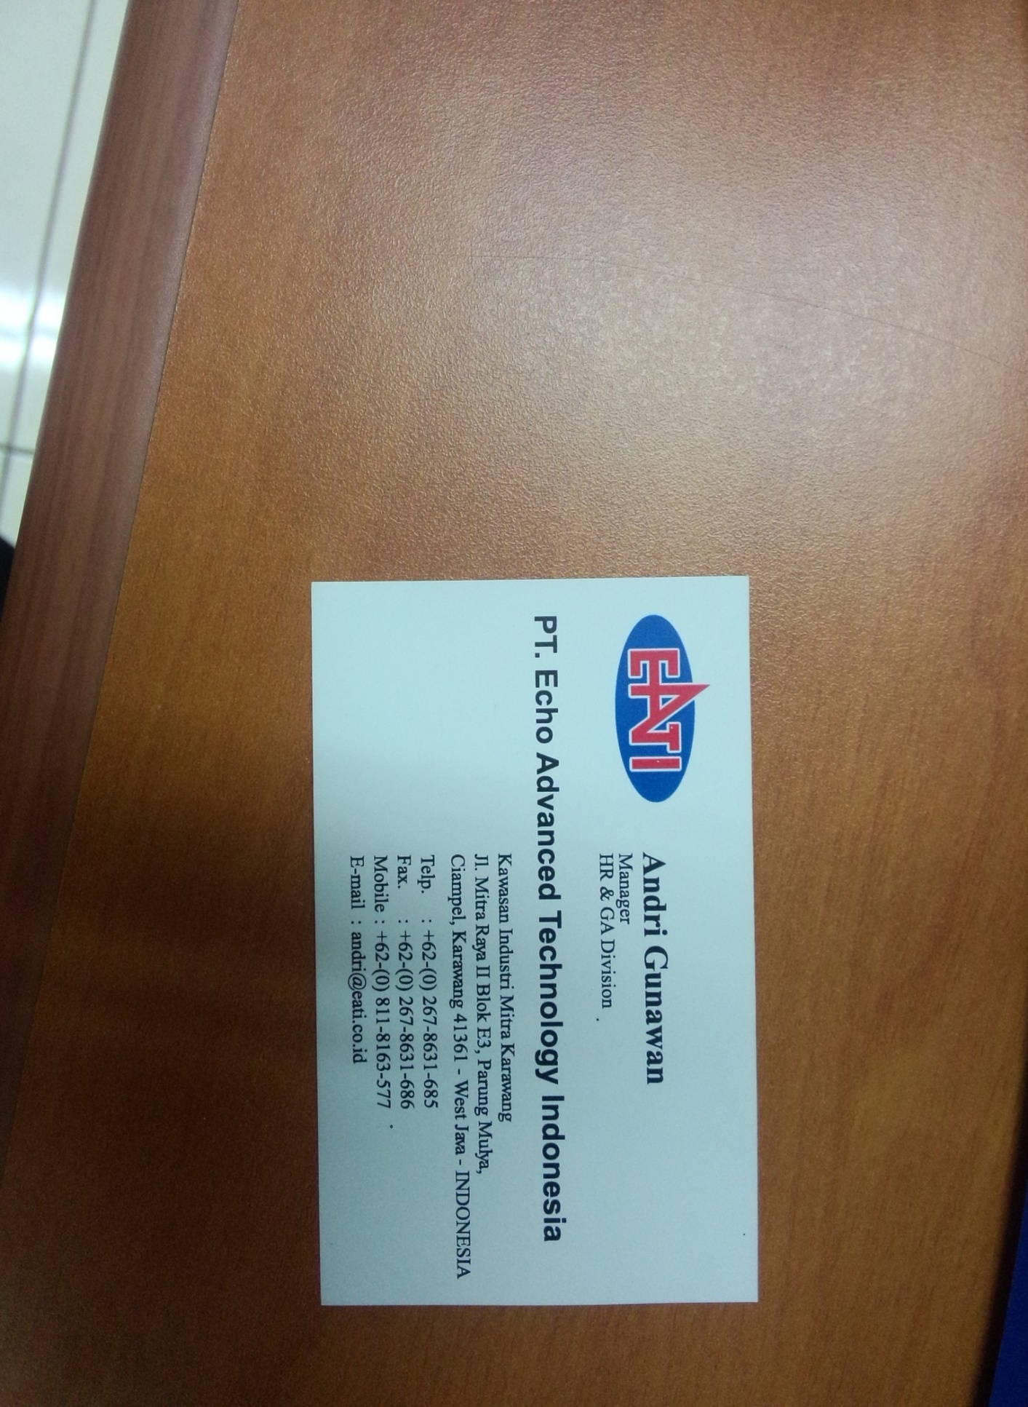






REFERENSI CUSTOMER
FACTORY
PT IHARA MANUFACTURING INDONESIA
PT HAIER ELECTRICAL APPLIANCES
PT SANKEN INDONESIA
PT JOTUN INDONESIA
PT FUTABA INDUSTRIAL INDONESIA
PT HOGY INDONESIA
PT JST INDONESIA
PT KANEFUSA INDONESIA
PT INDONESIA CHEMI-CON
PT FUJIMAKI STEEL INDONESIA
PT FINE SINTER INDONESIA
PT INDOJAPAN STEEL CENTER
PT ECHO ADVANCED TECHNOLOGY INDONESIA
PT ENPLAS INDONESIA
PT MAHLE INDONESIA
PT FLEXLINK SYSTEM
PT KRAMA YUDHA TIGA BERLIAN MOTORS

Slide 5
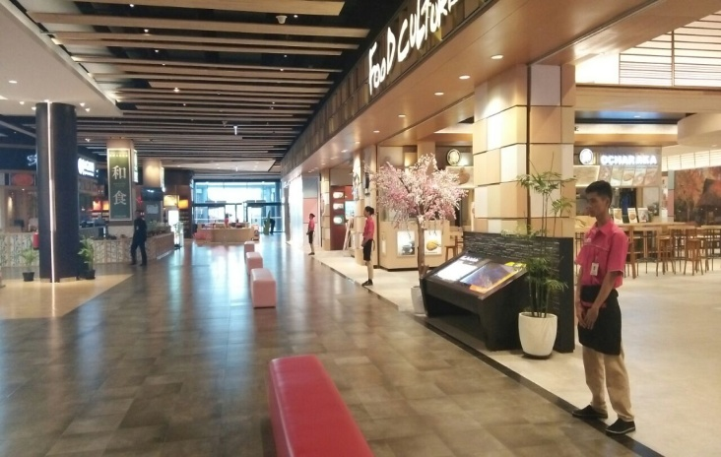
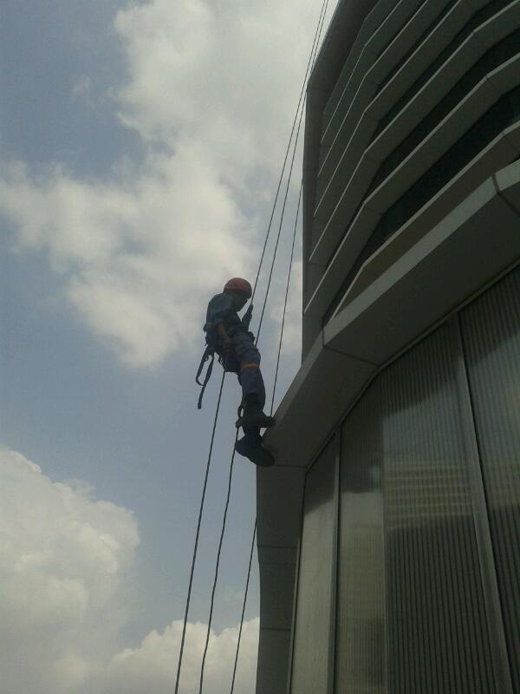
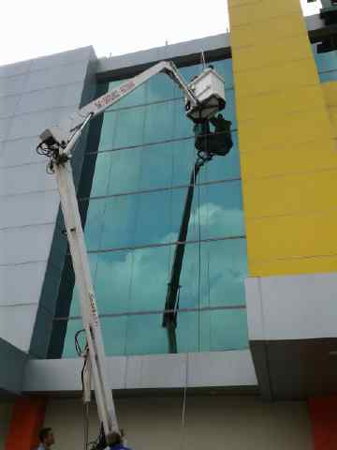
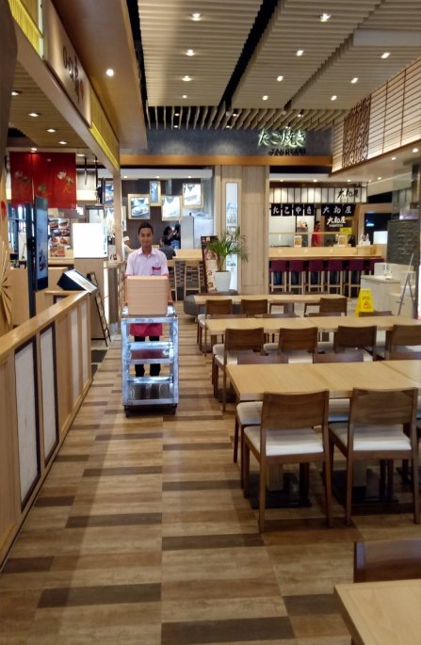
BUILDING MAINTENANCE & CLEANING SERVICE
Office Cleaning
Industrial Cleaning
Mall Cleaning
Hotel & Apartment Cleaning
Hospital Cleaning
Post Construction Cleaning
Home Cleaning

Slide 6
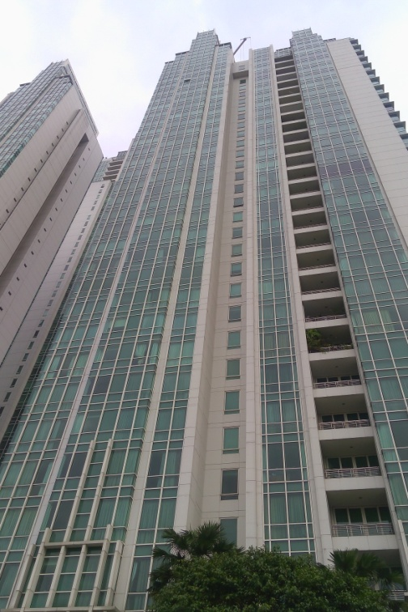
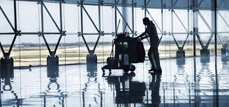
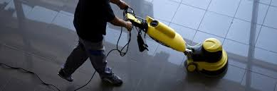
BUILDING MAINTENANCE & CLEANING SERVICE

Slide 7
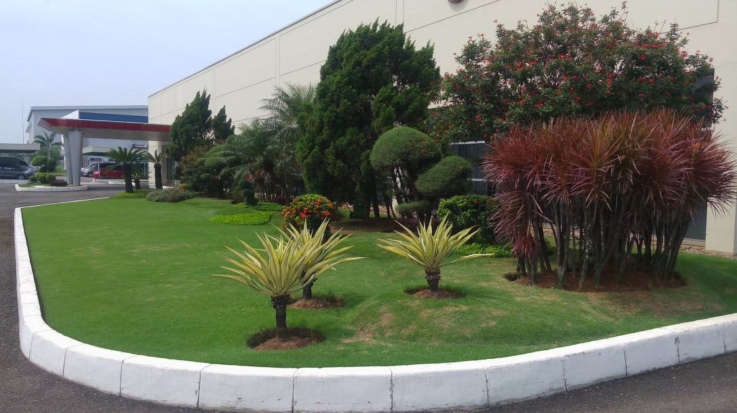
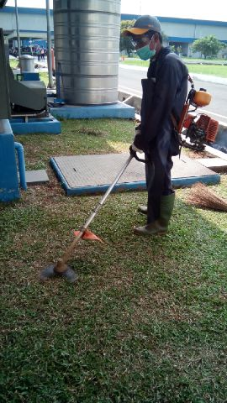
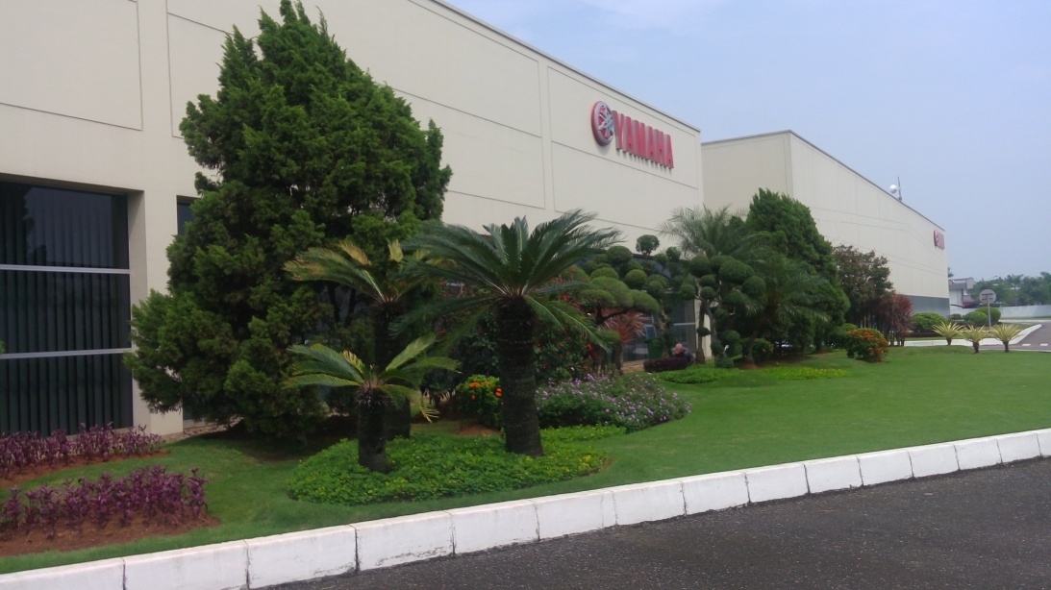
LANDSCAPE & OUTDOOR SERVICE
Outdoor Cleaning
Maintenance Garden
Design Landscape
Others

Slide 8
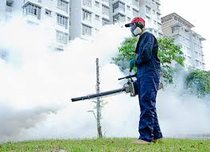
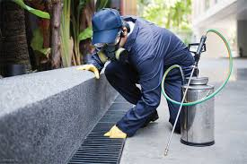
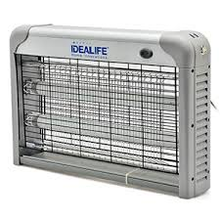
PEST & RODENT CONTROL
Factory
Office Building
Restaurant
Hotel & Apartment
Hospital
School
Mall
Others

Slide 9
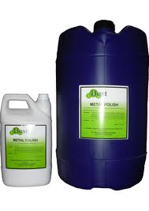
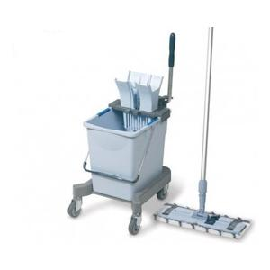
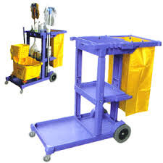
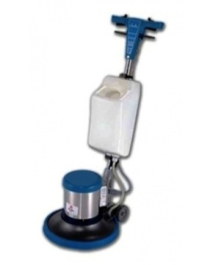
TRADING
Boy & Girl
Driver
Office Boy & Girl
Receptionist
Helper
Sales Promotion
METAL POLISH
Fungsi:
Digunakan untuk pembersihan dan perawatan material stainless steel / besi
JANITOR TROLLEY
Fungsi:
Penyimpanan alat agar mobilisasi peralatan lebih cepat dan pengangkutan sampah ringan
FLAT MOP
Fungsi:
Mopping dan Dusting secara bersamaan
Mesin Polisher
Fungsi : Mengkilapkan permukaan lantai setelah dilakukan pembersihan metode sebelumnya

Slide 10
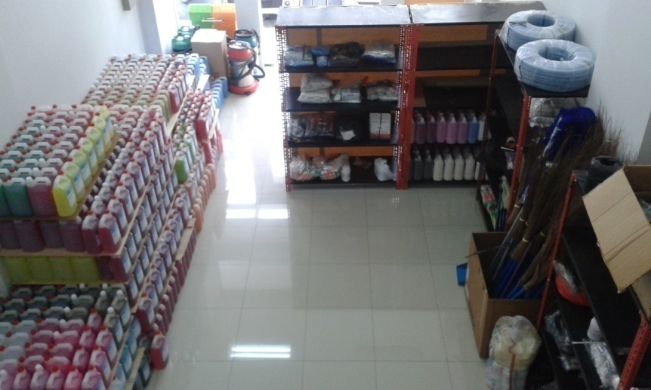
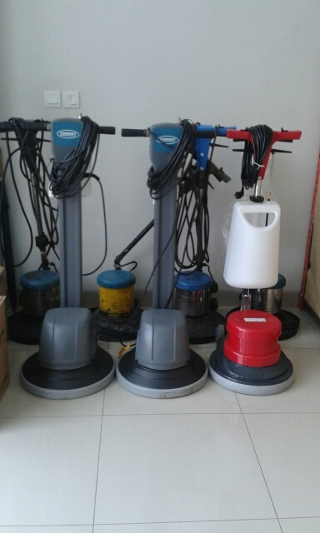
TRADING
Machinery
Tools & Equipment
Chemicals

